Slide 1
Program To Find The Permutation Matrix That Shows If Two Graphs Are Isomorphic From Their Adjacency Matrices
Third AUS Regional Students’ Conference On Mathematics
Rohan Mitra
Double Major Computer Science and Mathematics
b00085023@aus.edu

Slide 2
The Idea
Currently taking the course MTH418 – Graph Theory with Dr. Ayman Badawi
Graph theory relates very well to multiple fields in Computer Science
Had to find if two “Graphs” are “Isomorphic” for my homework. It’s a long process!
The programmer in me decided to find a faster way. Took about 10 mins to code the solution!
Had a few classmates test it out, and then shared it with professor and classmates on iLearn!

Slide 3







What is a Graph?
Different from the graphs on the x and y axes
A set of “Vertices” (Nodes) connected by “Edges” (Connections between these nodes)
Nodes / Vertices
Edges (Connections)

Slide 4
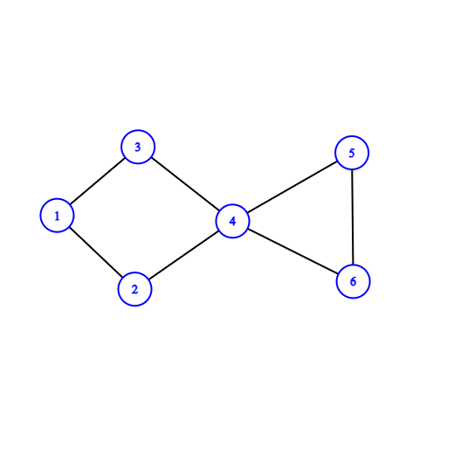
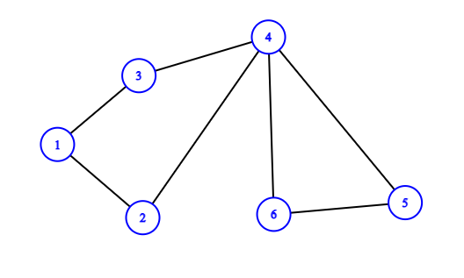
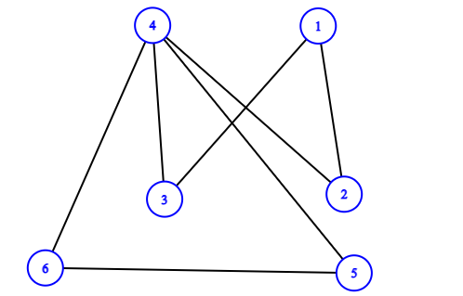

Isomorphism
$$G_{1}:$$
Same graph, drawn differently
Both graphs have the same properties
$G_{1}≈G_{2}$
$G_{1}≈G_{3}$
$$G_{2}:$$
$$G_{3}:$$

Slide 5



Adjacency Matrix
Matrix, with each row and column corresponding to each vertex/node
Put a 1 where there is an edge connecting the two nodes, else put a 0
$$G_{1}:$$
$$A_{1}:$$
1 2 3 4 5 6
1
2
3
4
5
6
$\left[\begin{aligned}\begin{matrix}0 & 1 & 1 \\ 1 & 0 & 0 \\ 1 & 0 & 0\end{matrix} \begin{matrix}0 & 0 & 0 \\ 1 & 0 & 0 \\ 1 & 0 & 0\end{matrix} \\ \begin{matrix}0 & 1 & 1 \\ 0 & 0 & 0 \\ 0 & 0 & 0\end{matrix} \begin{matrix}0 & 1 & 1 \\ 0 & 1 & 1 \\ 1 & 1 & 0\end{matrix}\end{aligned}\right]$

Slide 6
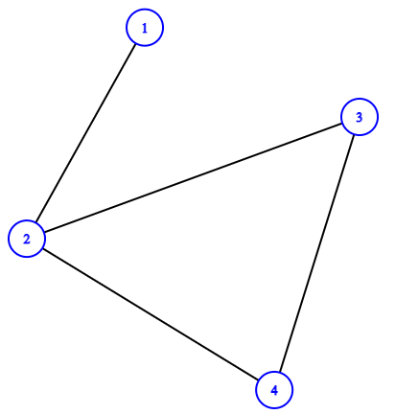
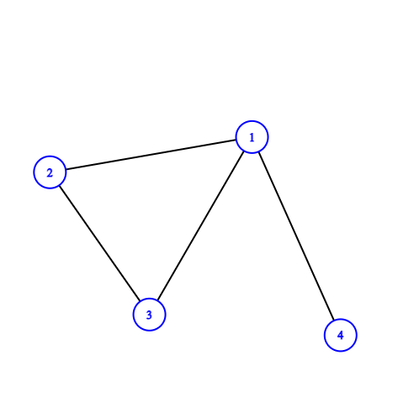









New Definition of Isomorphism
$$G_{1}:$$
$$G_{2}:$$
A more mathematical definition of Isomorphism can now be achieved
$G_{1}≈G_{2} if and only if$
$$for adjacency matrices$$
$$A_{1} and A_{2} we can find a$$
$$matrix P such that$$
$$PA_{1}=A_{2}P or PA_{2}=A_{1}P$$
Note: P may not be unique!
$$A_{1}:$$
$$A_{2}:$$
$$\left[\begin{aligned} \begin{matrix}0 & 1 \\ 1 & 0\end{matrix} \begin{matrix}0 & 0 \\ 1 & 1\end{matrix} \\ \begin{matrix}0 & 1 \\ 0 & 1\end{matrix} \begin{matrix}0 & 1 \\ 1 & 0\end{matrix}\end{aligned}\right]$$
$$\left[\begin{aligned} \begin{matrix}0 & 1 \\ 1 & 0\end{matrix} \begin{matrix}1 & 1 \\ 1 & 0\end{matrix} \\ \begin{matrix}1 & 1 \\ 1 & 0\end{matrix} \begin{matrix}0 & 0 \\ 0 & 0\end{matrix}\end{aligned}\right]$$
$$\left[\begin{aligned} \begin{matrix}0 & 1 \\ 0 & 0\end{matrix} \begin{matrix}0 & 0 \\ 1 & 0\end{matrix} \\ \begin{matrix}0 & 0 \\ 1 & 0\end{matrix} \begin{matrix}0 & 1 \\ 0 & 0\end{matrix}\end{aligned}\right]$$
$$P:$$

Slide 7
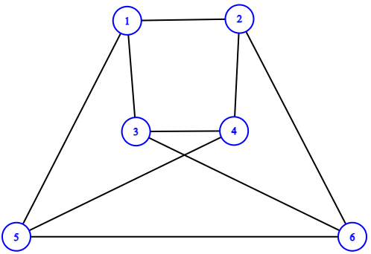
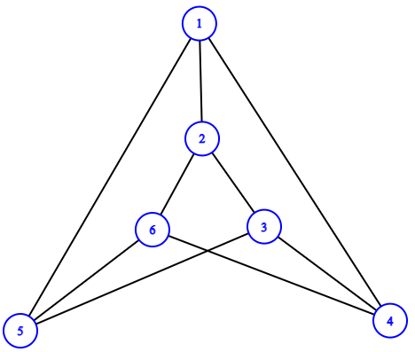
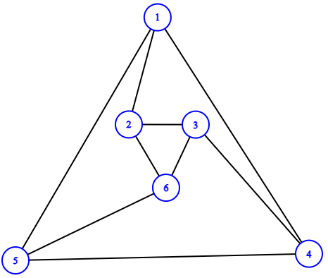









A more complicated Example
$\left[\begin{aligned}\begin{matrix}0 & 1 & 1 \\ 1 & 0 & 0 \\ 1 & 0 & 0\end{matrix} \begin{matrix}0 & 1 & 0 \\ 1 & 0 & 1 \\ 1 & 0 & 1\end{matrix} \\ \begin{matrix}0 & 1 & 1 \\ 1 & 0 & 0 \\ 0 & 1 & 1\end{matrix} \begin{matrix}0 & 1 & 0 \\ 1 & 0 & 1 \\ 0 & 1 & 0\end{matrix}\end{aligned}\right]$
$$G_{1}:$$
$$A_{1}:$$
$$G_{2}:$$
$\left[\begin{aligned}\begin{matrix}0 & 1 & 0 \\ 1 & 0 & 1 \\ 0 & 1 & 0\end{matrix} \begin{matrix}1 & 1 & 0 \\ 0 & 0 & 1 \\ 1 & 1 & 0\end{matrix} \\ \begin{matrix}1 & 0 & 1 \\ 1 & 0 & 1 \\ 0 & 1 & 0\end{matrix} \begin{matrix}0 & 0 & 1 \\ 0 & 0 & 1 \\ 1 & 1 & 0\end{matrix}\end{aligned}\right]$
$$A_{2}:$$
$$G_{3}:$$
$\left[\begin{aligned}\begin{matrix}0 & 1 & 0 \\ 1 & 0 & 1 \\ 0 & 1 & 0\end{matrix} \begin{matrix}1 & 1 & 0 \\ 0 & 0 & 1 \\ 1 & 0 & 1\end{matrix} \\ \begin{matrix}1 & 0 & 1 \\ 1 & 0 & 0 \\ 0 & 1 & 1\end{matrix} \begin{matrix}0 & 1 & 0 \\ 1 & 0 & 1 \\ 0 & 1 & 0\end{matrix}\end{aligned}\right]$
$$A_{3}:$$

Slide 8


Final Observations
Tested the program on multiple graphs (both isomorphic and non isomorphic)
Can be used to simplify complicated graphs (Show they are isomorphic to graphs with more “well known” properties).
Further work to further improve efficiency of the program (so it can run for graphs with a large number of vertices quickly)
Code can be found at: Run directly in your browser:

